Slide 1
Rendering and Data Fetching Techniques
Bhawna Gunwani
Corporate Trainer and Consultant

Slide 2
Next.js Rendering Methods

Slide 3
What is Next.js Rendering?
In Next.js, rendering refers to how content is prepared and delivered to users. Next.js offers several rendering methods to optimize the performance, SEO, and interactivity of web pages based on different application needs. These methods include Static Site Generation (SSG), Server-Side Rendering (SSR), Client-Side Rendering (CSR), and Incremental Static Regeneration (ISR).

Slide 4
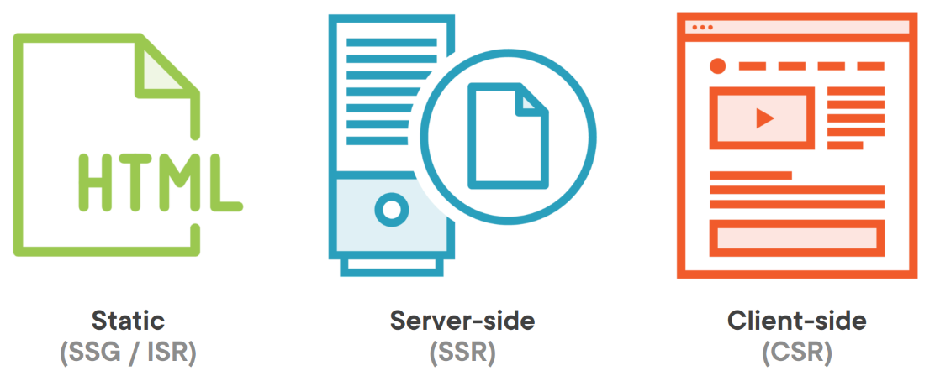
Rendering Approaches

Slide 5
Static Site Generation (SSG)
SSG generates HTML at build time for each page. This static HTML is then served to users, making it extremely fast because it doesn’t require server processing for each request. Ideal for pages where content doesn’t change frequently, such as marketing sites, blogs, and product landing pages.

Slide 6
Benefits
Fast Loads: Pre-rendered HTML for instant loading.
Highly Scalable: Serve via CDN for global reach.
SEO-Optimized: Full HTML for better indexing.
Secure: No runtime processing, fewer risks.
Low Server Load: Minimal server resources needed.

Slide 7
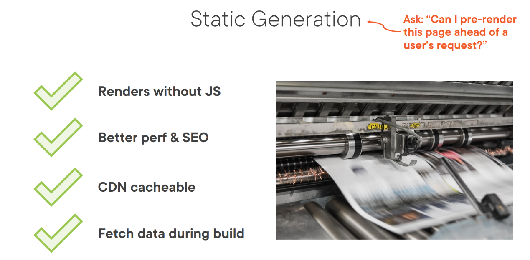

Slide 8
Server-Side Rendering (SSR)
SSR generates HTML on each request at runtime. When a user requests a page, the server renders the page and sends the complete HTML to the browser. Useful for dynamic content that must always be up-to-date, like personalized dashboards, user-specific content, and frequently changing data.

Slide 9
Benefits
Real-Time Data: Fresh content on every request.
SEO-Friendly: Content is available to search engines instantly.
Personalization: Tailor content per user session or request.
Enhanced Performance: Fast initial load for dynamic data.
Improved User Experience: Consistent, updated content on each load.
Secure Data Handling: Server processes sensitive data, not the client.

Slide 10
A page is static unless it uses
getServerSideProps or
GetInitialProps.

Slide 11
Client-Side Rendering (CSR)
CSR renders content in the browser after the initial page load. The HTML sent from the server is minimal, with JavaScript loading and rendering the content once it arrives. Suitable for interactive, user-driven content where SEO is not a priority, like dashboards and single-page applications (SPAs).

Slide 12
Benefits
Highly Interactive: Ideal for complex, user-driven interactions.
Reduced Server Load: Rendering happens in the browser, easing server strain.
Seamless Navigation: Allows smooth, app-like transitions between pages.
Fast Data Updates: Dynamically fetches data as users interact.
Flexible State Management: Simplifies managing user-specific states.

Slide 13
Data Fetching Techniques

Slide 14
What is Data Fetching?
Data fetching in web development refers to the process of retrieving data from a source (like an API, database, or external service) and displaying it within an application. This is essential for dynamically rendering content based on real-time or frequently updated data, such as user profiles, product listings, or news articles.

Slide 15


Slide 16
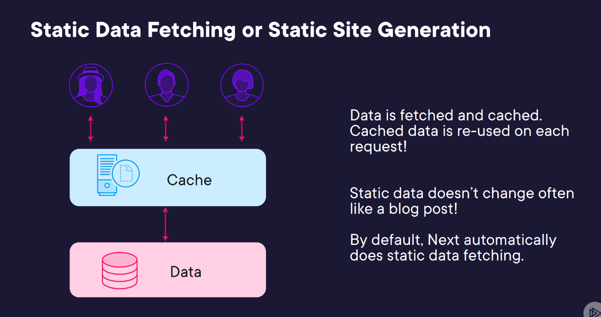

Slide 17
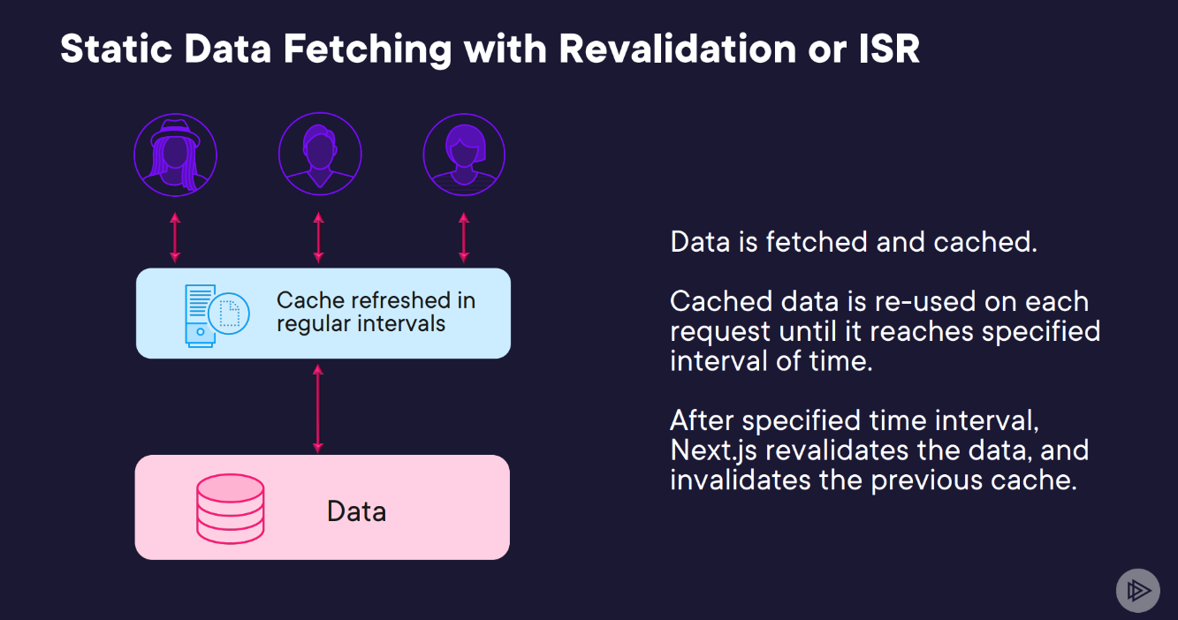

Slide 18
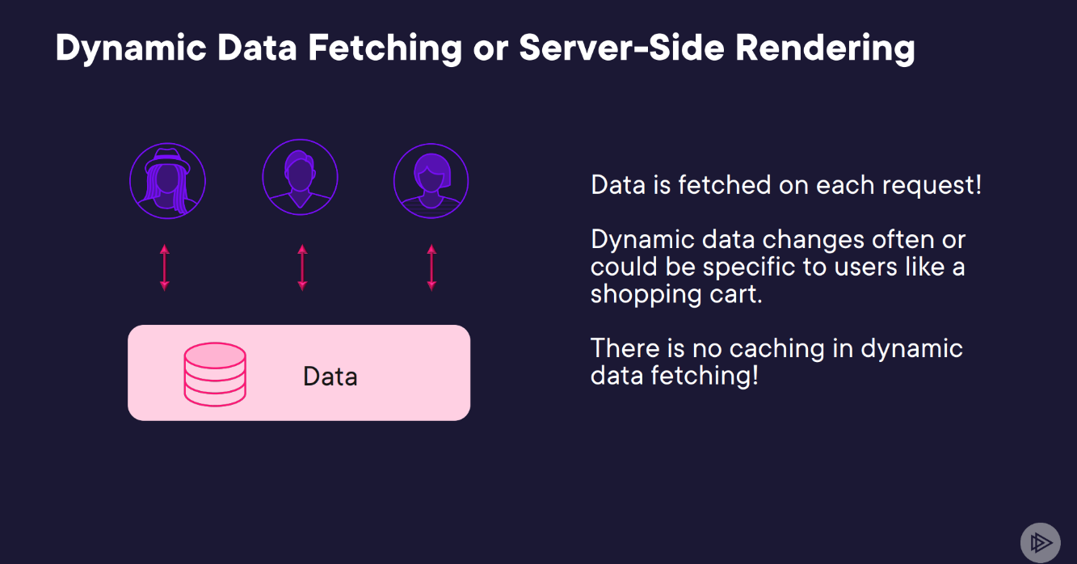

Slide 19
What is getStaticProps?
getStaticProps is a function in Next.js used specifically with Static Site Generation (SSG). It allows you to fetch data at build time to pre-render pages as static HTML, making them fast to load and highly optimized for performance and SEO.

Slide 20
What is getServerSideProps?
getServerSideProps is a function in Next.js used for Server-Side Rendering (SSR). It enables data fetching on each request, allowing pages to always have the most up-to-date data when rendered.

Slide 21
What is getStaticPaths?
getStaticPaths is a function in Next.js that works with Static Site Generation (SSG) to create dynamic routes at build time. It’s used to generate paths for pages with dynamic parameters, allowing Next.js to pre-render these pages as static files.

Slide 22
Choosing a Method
SSG: For static content with rare updates.
SSR: For real-time, dynamic, or user-specific content.
ISR: For mostly static content that needs occasional refreshes.
CSR: For highly interactive elements that load after the initial page render.

Slide 23




Slide 24

Coffee Break

Slide 25

Check your Knowledge

